Slide 1

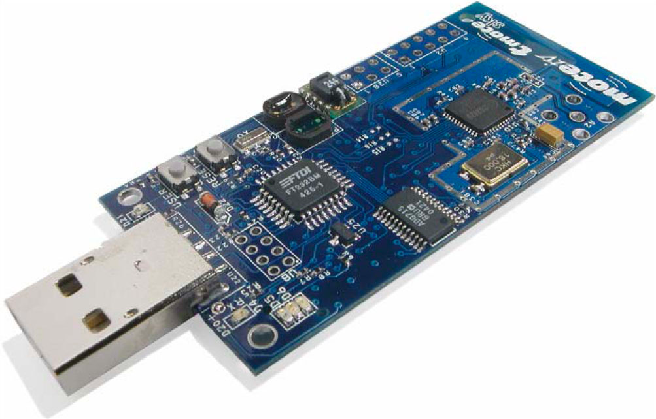
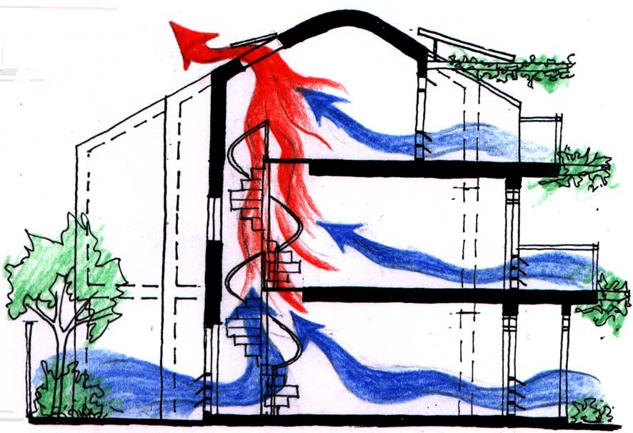

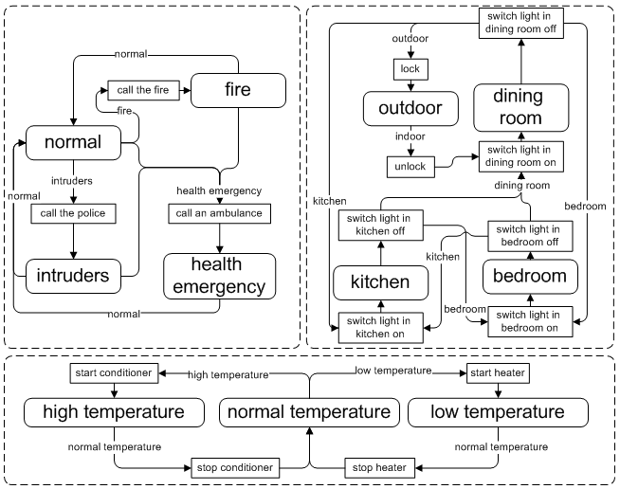



Towards Context-Oriented Programming for Wireless Sensor Networks
Mikhail Afanasov, Luca Mottola
Politecnico di Milano (Italy)
Contact email: thiemo@sics.se
Easy-way programming for Wireless Sensor Networks
Smart Home example
ConesC way
Expected Results
Comprehensive programming system enabling integration of WSNs and business processes
application-level editors
supporting tool-chain
efficient node-level run-time
Prototype deployment for building ventilation
UBICOMP13 – Zurich (Switzeland), September 8th-12th

